Slide 1
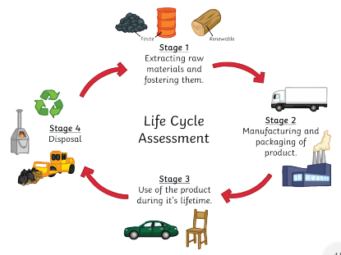
C10 – Using Resources
Earth’s Resources We use Earth’s resources to provide warmth, shelter, food and transport.
E.g.:
metals from the Earth’s crust to build buildings and cars
Timber and oil to burn for warmth
Crop plants for food
Products from crude oil to serve as fuels in cars, trains and planes
Finite resources – ones that will run out as they are being used much faster than they can be replaced, e.g. oil
Renewable resources – resources that will not run out, e.g. wood, wind etc.
Chemistry plays an important part in finding improvements or alternatives to current resources.
Life-Cycle Assessments (LCA) - These assess the environmental impact of a product in these stages:
Stage 1 – extracting raw materials needed to make products. - Energy cost and effect on habitats of extraction - Are the raw materials finite/renewable? Stage 2 – Manufacturing and packaging product - How much energy and resources are needed? - What waste products/pollution are released? - Transportation of goods from factors to user need considering. Stage 3 – Use of product during its lifetime - E.g. a car has a significant impact as needs filled up with petrol
which is a finite resource. Stage 4 – Disposal at end of product’s life. 1) Landfill – high environmental impact 2) Incineration – burning of product
3) Recycling – e.g. batteries contain metals that are harmful to environment – recycling means no new compounds need to be taken out of the ground.
Example LCA for plastic vs paper bags:
Stage of Life Cycle Assessment | Plastic Bag | Paper Bag
Stage 1 – raw material | Uses finite resource. Process of fractional distillation, cracking and polymerisation all require energy. | Made from trees/recycled paper. Making paper from trees required more energy than recycled paper. Less energy than plastic bags.
Stage 2 – Manufacture | Cheap to make | More expensive to make
Stage 3 – Use | Low environmental impact as can be re-used many times. Much stronger product. | Only be reused a limited number of times – short lifetime.
Stage 4 - disposal | Do not biodegrade easily in landfill. | Paper bags degrade easily in landfill sites.
Natural | Improved or replaced by….
Wood for furniture | Plastic/polymers
Food crops | Fertilisers/artificially grown foods such as Quorn
Oil for fuel | Ethanol/hydrogen fuel cells
Rubber for tyres | Polymers
- Different people have different opinions and so depends on who completes the LCA. Bias may be added. - Some companies may only discuss some of environmental impacts of their product. - Accurate numerical values should be used where possible – for example to show how much energy has been used.

Slide 2
C10 – Using Resources
What are the 4 main uses of the Earth’s materials?
What is a renewable resource?
What is a finite resource?
Give an example of a finite resource
Give an example of a renewable resource
Give an example of a natural product that has been replaced by modern chemistry or farming.
What does LCA stand for?
What does an LCA assess?
What are the 4 stages that are assessed in an LCA?
Suggest one environmental impact of extraction of raw materials such as metals or oil.
Name two ways products are disposed of at the end of their ‘life’
Why might an LCA be inaccurate?
What are the raw materials for a
a) paper bag
b) plastic bag
3. Why might the disposal of a plastic bag have a greater environmental impact than the disposal of a paper one?

Slide 3
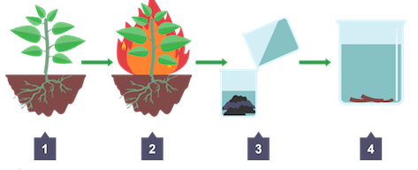
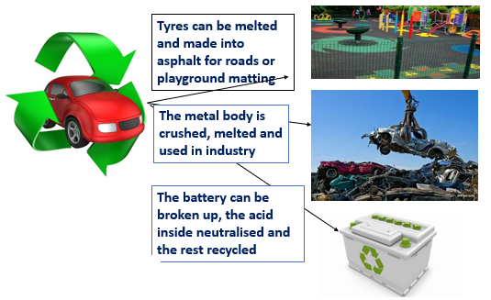
C10 – Using Resources
Reducing the use of resources
Metals, glass, ceramics, building materials and most plastics are produced from limited resources.
The energy for the processes involved in making/extracting raw materials also comes from limited resources – e.g. oil.
We can reduce the use of limited resources by reducing use, reusing materials and recycling materials at the end of their life.
Reduce, reuse, recycle.
E.g.
Glass bottles can be reused.
Metals can be melted down and recast and so recycled.
Scrap steel can be added to extracted iron to reduce the amount of iron that has to be extracted in the blast furnace.
Evaluating methods to reduce, reuse, recycle
Phytomining (HT only) 1) Plants are grown on a low-grade ore 2) The plants absorb metal ions through their roots 3) The plants are harvested and burnt 4) Ash left behind contains metal compounds 5) Ash is dissolved in acid and copper is extracted using electrolysis or displacement with scrap iron.
Advantages | Disadvantages
Fewer resources such as mines and quarries are needed to extract finite materials | Requires collection and transport of items – involving staff, vehicles and use of fuel
Crude oil does not need to be extracted – avoids high energy costs for fractional distillation etc. | Materials, such as metals, very often have to be separated from other materials first
Less greenhouse gases produced. | Some metals need melting before being reused – energy costs.
Less items in landfill
Biological extraction techniques (HT only) - Earth’s supply of metal ores is limited. - There are fewer sites that give lots of copper (high grade ore sites)
- New ways of extracting from low grade ore sites are:
- Phytomining - Bioleaching Disadvantage = slow processes Advantage = reduce need for the traditional mining methods of digging, moving and disposing of large amounts of rock.
Bioleaching (HT only) - Uses bacteria to produce a solution called leachate – contains copper ions.
- The copper can be extracted by using iron to displace the copper from the leachate. - Does not need high temperatures - Produces toxic substances which can damage the environment.
- Iron is cheaper than copper – use of scrap iron is a cost-effective way to produce copper from leachate. - Can also undergo electrolysis to produce copper.

Slide 4
C10 – Using Resources
Give three ways we can reduce our use of limited resources.
Give an example of a product that can be reused
What has to be done to metals before they can be recast?
How is scrap iron used to reduce the amount of iron needing to be extracted?
State two advantages of recycling.
State two disadvantages of recycling.
What organisms are used in phytomining?
What happens to the plants once they’ve grown?
What is used to displace the copper ions from solution?
What organisms are used in bioleaching?
What is a ‘high grade ore’ site?
Name the two biological extraction techniques
State a disadvantage of biological extraction techniques.

Slide 5
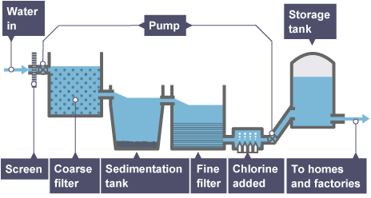
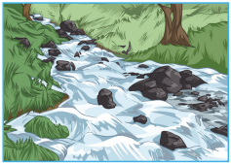
C10 – Using Resources Water
Potable Water - Water is essential for life. - Potable water is water that is safe to drink. - Potable water is not pure as it contains some dissolved substances. In the UK – rain water provides water with low levels of dissolved substances that collects in the ground and in lakes and rivers. This is fresh water. Most potable water is produced by: 1) Choosing an appropriate source of fresh water 2) Passing the water through filter beds 3) Sterilising to kill bacteria Sterilising agents used for potable water include: - Chlorine - Ozone - Ultraviolet light
Desalination of Sea Water - Potable water can be made from sea water through desalination. - Required a lot of energy to remove salt in sea water. Can be done by: Distillation - Sea water heated until it boils - Steam is condensed to make potable water - Requires a lot of energy Reverse Osmosis - Water put under high pressure and passed through membrane with tiny holes in. - Holes allow water through but not salt/ions - Very expensive - Produces large volumes of waste water.
Waste Water Treatment - Waste water needs to be treated before being released back into environment Pollutants can be present in waste water including: - Human waste contains harmful bacteria and nitrogen – can harm aquatic ecosystems. - Industrial waste can contain toxic substances - Agricultural waste water can contain fertilisers or pesticides – disrupt ecosystems. Sewage treatment involves: 1) Screening and grit removal to remove large particles 2) Sedimentation – allows tiny particles to settle – produces sewage sludge and effluent (liquid that remains on the top) 3) Sewage sludge is digested anaerobically by specific bacteria 4) Effluent is treated with aerobic bacteria to reduce volume of solid waste.

Slide 6
C10 – Using Resources
What is potable water?
What is fresh water?
Where does fresh water collect in the UK?
After finding an appropriate source of water, what two stages are needed to make it potable?
What are the 3 methods of sterilising water?
Why is water treated with chlorine?
1. How can potable water be made from sea water? 2. Give a disadvantage of this technique. 3. Describe the process of distillation. 4. Describe the process of reverse osmosis.
State three pollutants that may be present in waste water.
Complete the table to explain the steps in treating waste water.
Step | Explanation
Screening
Sedimentation
Anaerobic digestion
Aerobic digestion

Slide 7
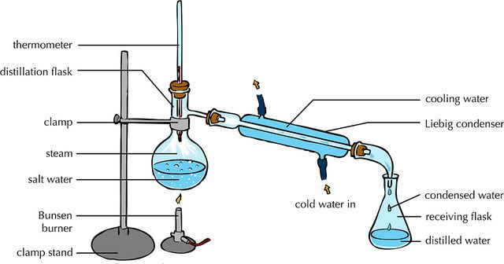
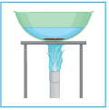
C10 – Using Resources – Required Practical – Analysis and purification of water
Analysing the pH of Water Samples - Test pH of each water sample using pH probe or universal indicator. - Compare to pH chart if using universal indicator
Analysis the Mass of Dissolved Solids 1) Measure out 50 cm³ of water sample using measuring cylinder. 2) Take the mass of evaporating basin using top pan balance. 3) Heat the sample in the evaporating basin gently until all liquid evaporates. 4) Let the evaporating basin cool 5) Re-take the mass of the evaporating basin. 6) Calculate the mass of the solid left behind by doing: final mass – initial mass. 7) Repeat with different water samples (e.g. rainwater, salt water, spring water)
Distillation of water Sample
Set up apparatus as shown in picture with the sample of water in the round bottom flask.
Heat water sample until it boils gently.
Water vapour enters the tube at the side (condenser)
There is cold water surrounding the tube
The water vapour cools and condenses and collects in the flask.
The water collected should be pure.

Slide 8
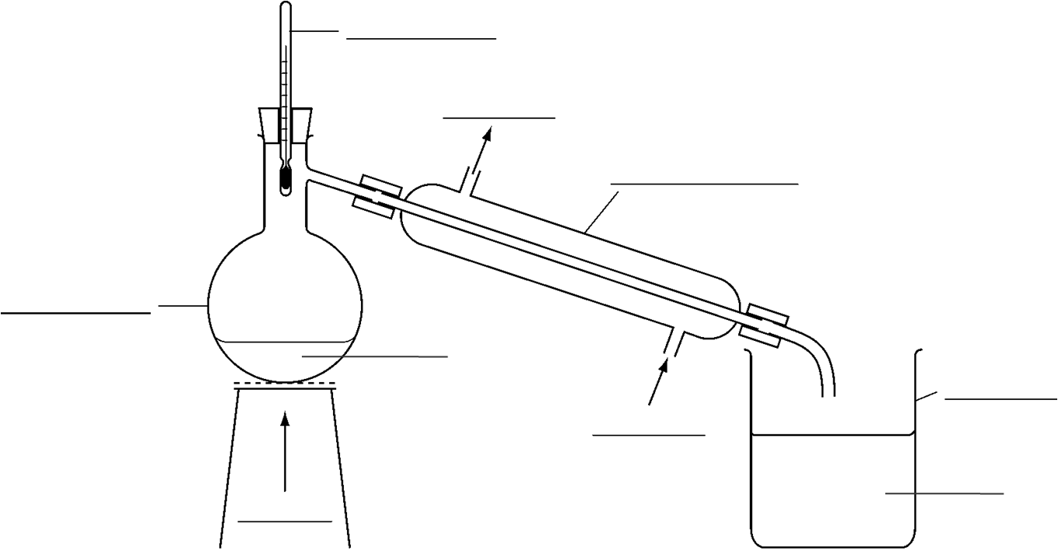
C10 – Using Resources – Required Practical – Analysis and purification of water
1. Write a method of how to investigate the mass of solids in different samples of water.
Label the diagram below to show how to purify salt water.
What is the name of this technique?
What two changes of state happen during this?
Describe the water that is collected in the beaker
Bunsen, water sample, water, beaker, condenser, water in, water out, thermometer, round bottom flask

